Slide 1

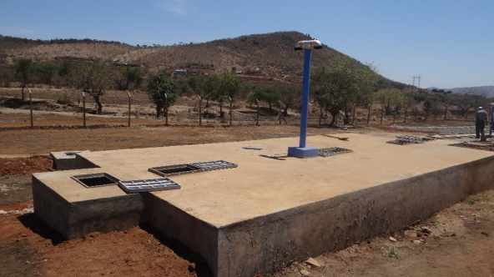
SETTLER
TECHNICAL SPECIFICATION AND REQUIREMENTS

Slide 2
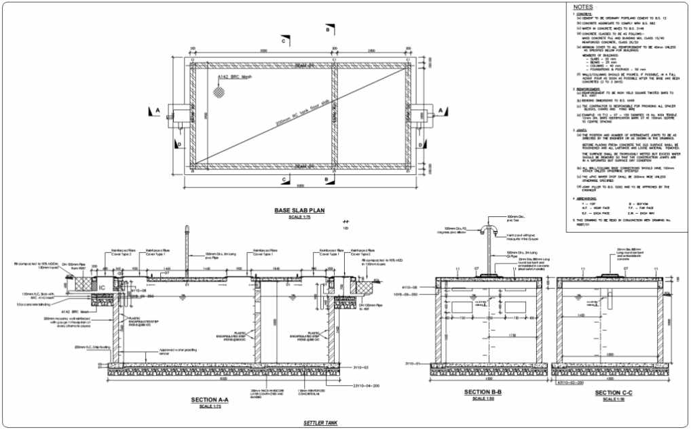

Slide 3
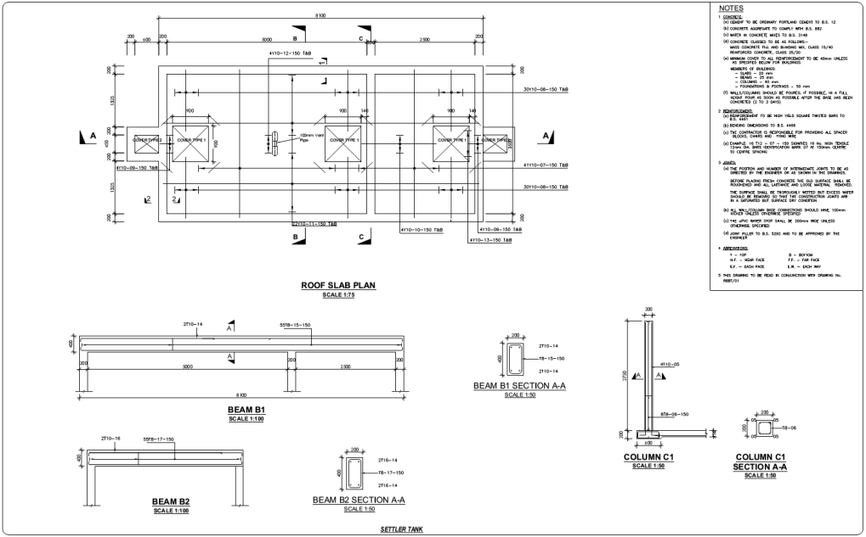

Slide 4
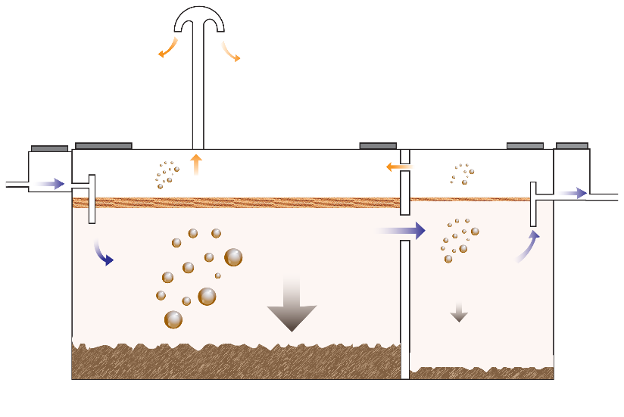
IMPORTANCE OF LEVELS

Slide 5
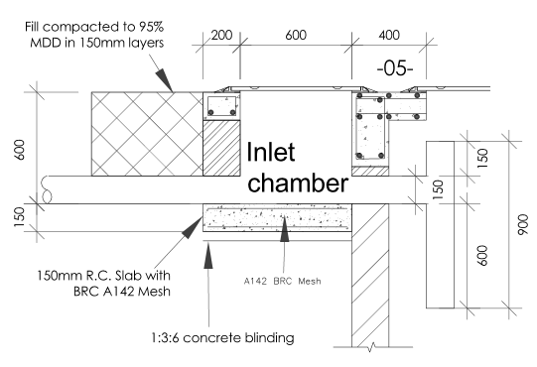
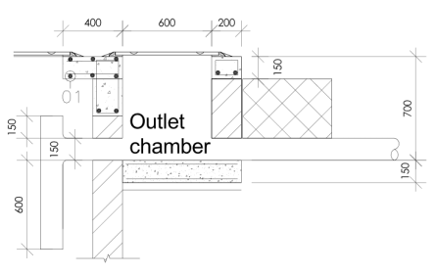
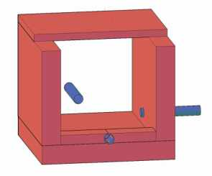
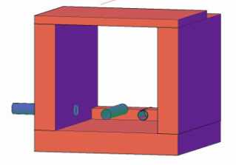
INLET AND OUTLET CHAMBER
Outlet pipe
Bypass pipe
Inlet pipe
Inlet pipe
Bypass pipe
Outlet pipe

Slide 6
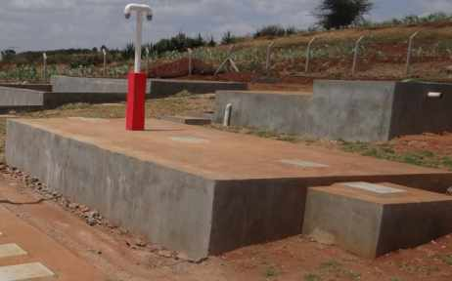
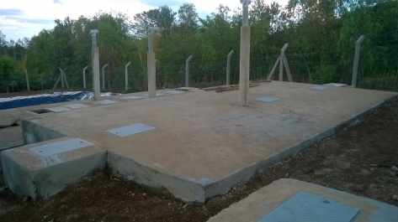
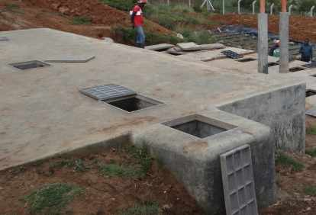
DIFFERENT EXAMPLES OF SETTLER

